Slide 1
Docker

Slide 2
What is Docker
Docker is an open platform for developing, shipping, and running applications.
Docker packages software into standardized units called containers that have everything the software needs to run including libraries, system tools, code, and runtime which makes it highly portable so you do not need to rely on what is currently installed on the host.
Docker provides the ability to package and run an application in a loosely isolated environment called a container.
Docker demon : Listens for Docker API requests and manages Docker objects.
Docker client : One who runs the docker command.
Docker image : Created by dockerfile and used to create docker container.
Docker container: A container is a runnable instance of an image.
Amazon ECS is used to run containers.

Slide 3
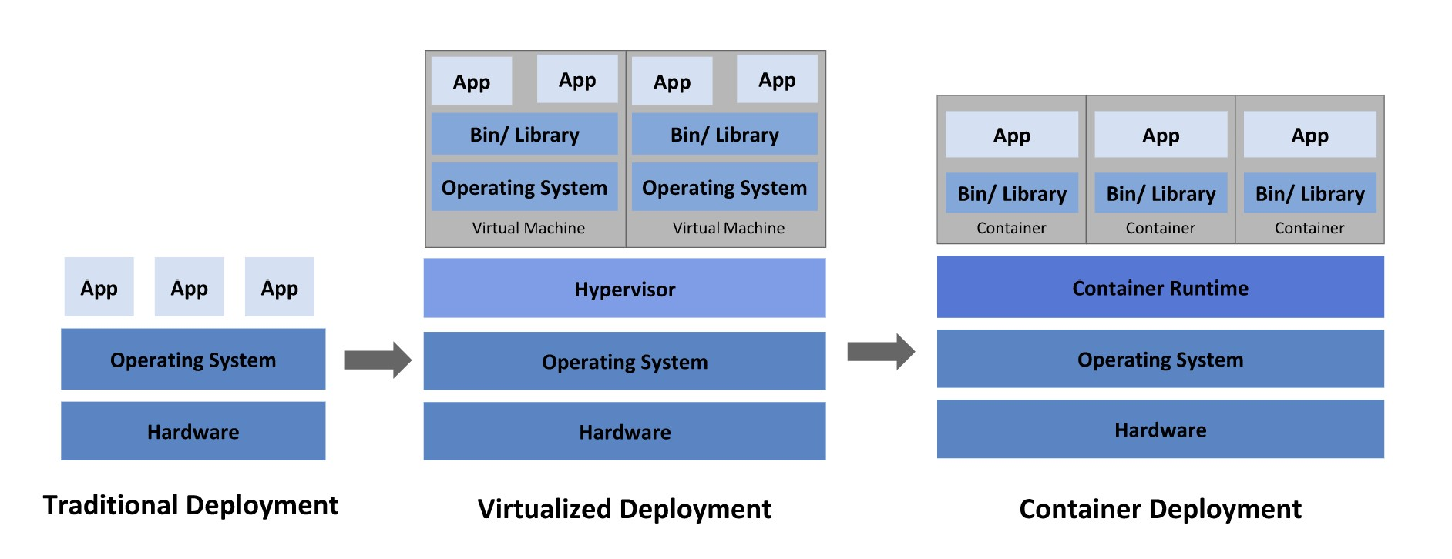
Deployment Type

Slide 4
Let’s start Using Docker
$docker version.
$docker info.
Public and private repo (Docker hub, ECR).
User needs to create account on docker hub.
$docker login Username: Password
Check Docker Save

Slide 5
DockerFile
FROM: Specifies the base image to use for the build.
RUN: Executes a command inside the image during the build process.
COPY or ADD: Copies files or directories from the host into the image.
WORKDIR: Sets the working directory for subsequent instructions.
ENV: Sets environment variables inside the image.
EXPOSE: Exposes a port at runtime.
CMD or ENTRYPOINT: Defines the command to run when a container is started.

Slide 6
Dockerfile
COPY vs ADD
Download from URL functionality in ADD
CMD vs ENTRYPOINT
The CMD sets the default command or arguments which can be overridden while the ENTRYPOINT has the main instruction to be executed.

Slide 7
Docker image
$docker build . -t prisharma2808/helloworld:1.0.0
$ docker images

Slide 8
Docker pull/push
$docker pull debian
$docker pull ubuntu:22.04
$docker pull debian@sha256:432f545c6ba13b79e2681f4cc4858788b0ab099fc1cca799cc0fae4687c69070
$docker push prisharma2808/helloworld:1.6.0

Slide 9
Docker Container
docker run prisharma2808/helloworld:1.1.0
docker container ls
docker run –rm -d <image-name>
docker rm
docker container ls -a
docker ps
docker attach container id
docker top container id
docker logs container id
docker start container id
docker stop container id

Slide 10
Volume and Network
$docker volume ls
$docker run -dp 3000:3000 --mount type=volume,src=todo-db,target=/etc/todos getting-started
$docker run -it --mount type=bind,src="$(pwd)",target=/src ubuntu bash
$docker network ls
$docker network create todo-app

Slide 11
EXAMPLE
$docker run -d \
--network todo-app --network-alias mysql \
-v todo-mysql-data:/var/lib/mysql \
-e MYSQL_ROOT_PASSWORD=secret \
-e MYSQL_DATABASE=todos \
mysql:8.0
$docker run -it --network todo-app nicolaka/netshoot

Slide 12
Docker compose
Docker compose helps running more than one container.
$docker-compose up -d

